Slide 1

Java Performance
Dima Ionut Daniel

Slide 2
Contents
What is Java?
History
Tools
JVM
Garbage Collection
Heap Memory
Native Memory
Threading
Tools
Bibliography

Slide 3

What is Java?
Java is a programming language created by Sun Microsystems.
Java is used in a wide variety of computing platforms from embedded devices and mobile phones on the low end, to enterprise servers and supercomputers on the high end.
Java eliminates certain low-level constructs such as pointers and has a very simple memory model where every object is allocated on the heap and all variables of object types are references.
Memory management is handled through integrated automatic garbage collection performed by the JVM.
The heart of the Java platform is the concept of a "virtual machine" that executes Java bytecode programs. This bytecode is the same no matter what hardware or operating system the program is running under.

Slide 4
What is Java? (cont.)
There is a JIT(Just-In-Time) compiler within the Java Virtual Machine, or JVM. The JIT compiler translates the Java bytecode into native processor instructions at run-time and caches the native code in memory during execution. The use of a JIT compiler means that Java applications, after a short delay during loading and once they have "warmed up" by being all or mostly JIT-compiled, tend to run about as fast as native programs.
The Java programs are cross-platform or platform independent, but the code of the Java Virtual Machines (JVM) that execute these programs is not.

Slide 5
History
The initial Java release was named Oak, and the first stable version was JDK 1.0.2, called Java 1.
JDK 1.0 - 23 January 1996
JDK 1.1 – 19 February 1997
J2SE 1.2 – 8 December 1998 (codename Playground)
J2SE 1.3 – 8 May 2000 (codename Kestrel)
J2SE 1.4 – 6 February 2002 (codename Merlin)
J2SE 5.0 – 30 September 2004 (codename Tiger)
Java SE 6 – 11 December 2006 (codename Mustang)
Java SE 7 – 7 July 2011(codename Dolphin)
Java SE 8 is expected in summer 2013
The Java distribution comes in different flavors:
Java Card →run securely on smart cards and similar small-memory devices.
Java ME(Micro Edition) → Specifies several different sets of libraries (known as profiles) for devices with limited storage, display, and power capacities.
Java SE(Standard Edition) → for general-purpose use on desktop PCs, servers and similar devices.
Java EE(Enterprise Edition) → Java SE plus various APIs useful for multi-tier client–server enterprise applications.

Slide 6
Tools
On Unix-based systems, there are useful tools like vmstat, iostat,prstat, and so on.
On Windows, there are graphical resource monitors as well as command-line utilities like typeperf.
jcmd: Prints basic class, thread, and VM information for a Java process.
jconsole: Provides a graphical view of JVM activities, including thread usage, class usage, and GC activities.
jhat: Reads and helps analyze memory heap dumps. This is a postprocessing utility.
jmap: Provides heap dumps and other information about JVM memory usage.
jinfo: Provides visibility into the system properties of the JVM, and allows some system properties to be set dynamically.
jstack: Dumps the stacks of a Java process. Suitable for scripting.
jstat: provides information about GC and class-loading activities.
jvisualvm: A GUI tool to monitor a JVM, profile a running application, and analyze JVM heap dumps.

Slide 7
JVM
With a few exceptions, the JVM accepts two kinds of flags: boolean flags, and flags that require a parameter.
Boolean flags use this syntax: -XX:+FlagName enables the flag, and -XX:-FlagName disables the flag.
Flags that require a parameter: -XX:FlagName=something.
Java 7 and 8 introduce a number of new features and tools that make it even easier to get the best possible performance from a Java application.

Slide 8
Garbage Collections
GC consists of finding objects that are no longer in use, and freeing the memory associated with those objects.
All garbage collectors work by splitting the heap into different generations.
old (or tenured) generation.
the young generation.
The young generation is further divided into sections known as eden and the survivor spaces.

Slide 9
Garbage Collections (cont.)
The simpler algorithms stop all application threads, find the unused objects and free their memory, and then compact the heap.
This process is called a full GC, and it generally causes a long pause for the application threads.
The JVM provides four different algorithms for performing GC:
The serial garbage collector
The throughput collector
The CMS collector
The G1 collector

Slide 10
Garbage Collections (cont.)
The serial garbage collector:
default collector if the application is running on a client-class machine.
uses a single thread to process the heap.
during a full GC, it will fully compact the old generation.
enabled by using the -XX:+UseSerialGC flag
The throughput collector:
default collector for server-class machines.
uses multiple threads to collect the young generation.
is the default behavior in JDK 7u4 and later releases.
can be enabled in earlier JDK 7 JVMs by specifying the -XX:+UseParallelOldGC flag.
Because it uses multiple threads, the throughput collector is often called the parallel collector.

Slide 11
Garbage Collections (cont.)
The CMS collector:
designed to eliminate the long pauses associated with the full GC cycles of the throughput and serial collectors.
uses a different algorithm to collect the young generation (-XX:+UseParNewGC) than the throughput collector uses (-XX:+UseParallelGC).
it's a low-pause collector.
the trade-off here comes with increased CPU usage.
enabled by specifying the flags -XX:+UseConcMarkSweepGC -XX:+UseParNewGC
The G1 collector
designed to process large heaps (greater than about 4 GB)
divides the heap into a number of regions, but it is still a generational collector.
enabled by specifying the flag -XX:+UseG1GC

Slide 12
Garbage Collections (cont.)
The serial collector is best used only in those cases where the the application uses less than 100 MB.
If extra CPU is available then using a concurrent collector will give the application a nice performance boost.
CMS is the better of the concurrent collectors when the heap is small.
G1 is designed to process the heap in regions, so it will scale better than CMS on large heaps.

Slide 13
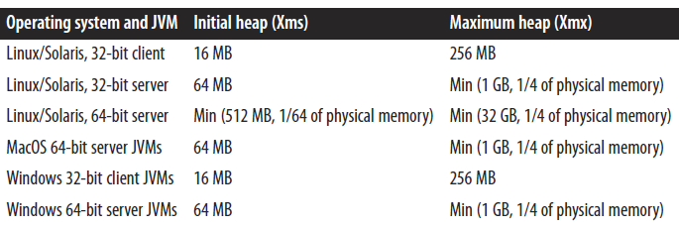
Garbage Collections (cont.)
Choosing a heap size is a matter of balance.
If the heap is too small, the program will spend too much time performing GC and not enough time performing application logic.
The time spent in GC pauses is dependent on the size of the heap, so as the size of the heap increases, the duration of those pauses also increases.
The size of the heap is controlled by two values: an initial value (specified with -XmsN) and a maximum value (-XmxN).

Slide 14
Garbage Collections (cont.)
We can decide how much of the heap to allocate to the young generation, and how much to allocate to the old generation.
-XX:NewRatio=N → Set the ratio of the young generation to the old generation.
-XX:NewSize=N -→ Set the initial size of the young generation.
-XX:MaxNewSize=N → Set the maximum size of the young generation.
-XmnN → Shorthand for setting both NewSize and MaxNewSize to the same value.
The young generation is first sized by the NewRatio, which has a default value of 2.
Initial Young Gen Size = Initial Heap Size / (1 + NewRatio)

Slide 15
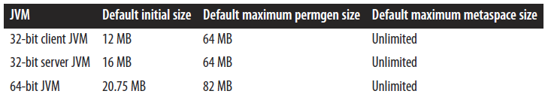
Garbage Collections (cont.)
When the JVM loads classes, it must keep track of certain metadata about those classes.
This data is held in a separate heap space.
In Java 7, this is called the permgen (or permanent generation), and in Java 8, this is called the metaspace.
Permgen and metaspace are not exactly the same thing.
Information in permgen/metaspace is really only used by the compiler and JVM runtime,and the data it holds is referred to as class metadata.
For permgen, the sizes are specified via these flags: -XX:PermSize=N and -XX:MaxPermSize=N.
Metaspace is sized with these flags: -XX:MetaspaceSize=N and -XX:MaxMetaspaceSize=N.

Slide 16
Garbage Collections (cont.)
All GC algorithms except the serial collector use multiple threads.
The number of these threads is controlled by the -XX:ParallelGCThreads=N flag.
Because these GC operations stop the application threads from executing, the JVM attempts to use as many CPU resources as it can in order to minimize the pause time.
The basic number of threads used by all GC algorithms is based on the number of CPUs on a machine.
When multiple JVMs are run on a single machine, that number will be too high and must be reduced.

Slide 17
Garbage Collections (cont.)
There are multiple ways to enable the GC log: specifying either of the flags -verbose:gc or -XX:+PrintGC will create a simple GC log.
The -XX:+PrintGCDetails flag will create a log with much more information.
It is recommended to include -XX:+PrintGCTimeStamps or -XX:+PrintGCDateStamps, so that the time between GC operations can be determined.
The GC log is written to standard output, though that location can be changed with the -Xloggc:filename flag.
Logfile rotation is controlled with these flags: -XX:+UseGCLogFileRotation -XX:NumberOfGCLogFiles=N -XX:GCLogFileSize=N.
By default, UseGCLogFileRotation is disabled.

Slide 18
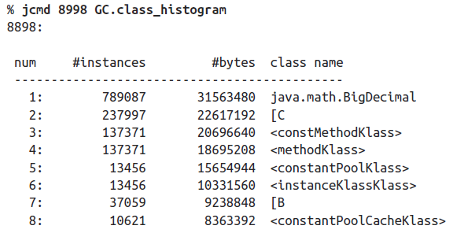
Heap Memory
Java jcmd tool can check heap histograms.
Histograms show information about number of objects(instances) and the size in memory within an application without doing a full heap dump.
[C stands for char arrays;[B stands for byte arrays.
Similar output can be obtains using jmap command: jmap –histo 8998
jmap –histo:live 8998 → it will force a full GC before showing the instances/bytes/class names.

Slide 19
Heap Memory (cont.)
In case of deeper analysis, a heap dump is required.
There are tools that can check heap dump or connect to a live app and generate the dump.
Example:
jcmd process_id GC.heap_dump heap_dump.hprof
jmap -dump:live,file=heap_dump.hprof process_id

Slide 20
Heap Memory (cont.)
Out of memory errors can occur unpredictably, making it difficult to know when to get a heap dump.
There are several JVM flags that can help.
-XX:+HeapDumpOnOutOfMemoryError → causes the JVM to create a heap dump whenever an out of memory error is thrown.
-XX:HeapDumpPath=<path> → specifies the location where the heap dump will be written. Defaults is: java_pid<pid>.hprof.
-XX:+HeapDumpAfterFullGC → generates a heap dump after running a full GC.
-XX:+HeapDumpBeforeFullGC → generates a heap dump before running a full GC.

Slide 21
Heap Memory (cont.)
The JVM can throw an out of memory error is when it determines that is it spending too much time performing GC:
Exception in thread "main" java.lang.OutOfMemoryError: GC overhead limit exceeded
Conditions:
The amount of time spent in full GCs exceeds the value specified by the -XX:GCTimeLimit=N flag(default value is 98).
The amount of memory reclaimed by a full GC is less than the value specified by the -XX:GCHeapFreeLimit=N flag. The default value for this is 2, meaning that if less than 2% of the heap is freed during the full GC, this condition is met.
The value of the -XX:+UseGCOverheadLimit flag is true (default value)

Slide 22
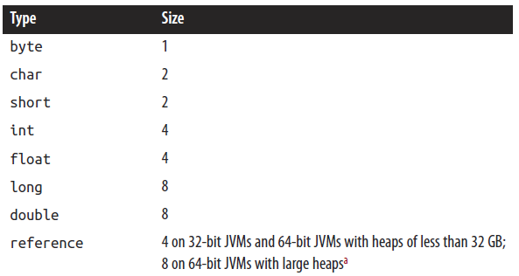
Heap Memory (cont.)
The first approach to using memory more efficiently in Java is to use less heap memory
The simplest way to use less memory is to make objects smaller.
Reducing object sizes can often improve the efficiency of GC.
Even null instance variables consume space within object classes.

Slide 23
Heap Memory (cont.)
We can improve object creation by using object pools and thread-local variables.
Objects that are reused stay around for a long time in the heap.
If there are a lot of objects in the heap, then there is less room to create new objects, and hence GC operations will occur more frequently.
Expensive objects creation: Thread pools, EJB pools, JDBC pools, large arrays, Native NIO buffers, Security Classes, Random number generators, String/ZIP encoders/decoders.

Slide 24
Heap Memory (cont.)
Pools of objects are inevitably synchronized.
The result is that access to the pool can become slower than initializing a new object.
When attempting to increase load on a system beyond what it can handle, performance will decrease.
Thread-local variables need no synchronization since they can only be used within a single thread; the thread-local get() method is relatively fast.

Slide 25
Heap Memory (cont.)
Weak and soft references in Java also allow objects to be reused.
A reference (or object reference) is any kind of reference: strong, weak, soft.
An indefinite reference is actually an instance of an object.
Indefinite references work by embedding another reference within an instance of the indefinite reference class. The encapsulated object is called the referent.
When running an application that uses a lot of indefinite references, we can add the -XX:+PrintReferenceGC flag (which is false by default).
Weak references should be used when the referent in question will be used by several threads simultaneously.
Objects that are only weakly referenced are reclaimed at every GC cycle.

Slide 26
Heap Memory (cont.)
Every Java class has a finalize() method inherited from the Object class;
That method can used to clean up data once the object is eligible for GC.
In practice, it turns out to be a bad idea, and it's best not to use this method.
Finalizers are bad for functional reasons, and they are also bad for performance.

Slide 27
Native Memory
JVM uses memory for its internal operations.
The nonheap memory is native memory.
Native memory can also be allocated in applications (via JNI calls to malloc() and similar methods, or when using New I/O, or NIO).
Useful tool to measure program performance: top, ps on Unix and perfomn/VMMap on windows.

Slide 28
Native Memory (cont.)
Every time the JVM creates a thread, the OS allocates some native memory to hold that thread’s stack, committing more memory to the process.
Native memory can be allocated via JNI calls, but NIO byte buffers will also allocate native memory if they are created via the allocateDirect() method.
The allocateDirect() method call is quite expensive; direct byte buffers should be reused as much as possible.
The total amount of memory that can be allocated for directbyte buffers is specified by setting the -XX:MaxDirectMemorySize=N flag.
Starting in Java 7, the default value for this flag is 0, which means there is no limit.

Slide 29
Native Memory (cont.)
Beginning in Java 8, the JVM allows some visibility into how it allocates native memory when using this option: -XX:NativeMemoryTracking=off|summary|detail.
By default, Native Memory Tracking (NMT) is off.
Example: jcmd process_id VM.native_memory summary.

Slide 30
Native Memory (cont.)
A page is a unit of memory by which operating systems manage physical memory.
Machines have a limited number of TLB entries, so it becomes important to maximize the hit rate on TLB entries.
Java supports this with the -XX:+UseLargePages option.
On Linux, the UseLargePages flags is not enabled by default, and the OS must also be configured to support large pages.
On Solaris, no OS configuration is required, and large pages are enabled by default.
# grep Hugepagesize /proc/meminfo
Hugepagesize: 2048 kB
Example: java -Xms4G -Xmx4G -XX:+UseLargePages -version

Slide 31
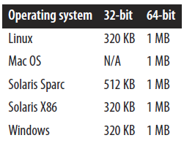
Threading
Many Java application servers use instances of the ThreadPoolExecutor class to manage their tasks.
Thread pools have a minimum and maximum number of threads.
The ThreadPoolExecutor and related classes refer to the minimum number of threads as the core pool size.
Each thread has a native stack, which is where the OS stores the call stack information of the thread.
The potential downside to setting this value too small is that a thread with an extremely large call stack will throw a StackOverflowError.
To change the stack size for a thread, use the -Xss=N flag (Example: -Xss=256k).

Slide 32
Threading (cont.)
Biased Locking
If a thread recently used a lock, the processor’s cache can contain data the thread will need the next time it executes code protected by that same lock.
Locking requires some bookkeeping, it can sometimes be worse for performance.
A small performance improvement can be obtained by disabling biased locking using the -XX:-UseBiasedLocking option.
Biased locking is enabled by default.

Slide 33
Threading (cont.)
Lock Spinning
The JVM has two options for handling a synchronized lock that is contended.
The thread that is blocked from accessing the lock can enter a busy loop or the thread can be placed in a queue.
The JVM will find a reasonable balance between these two cases.
Previous versions of Java supported a flag to enable or disable spin locks: -XX:+UseSpinning.
In Java 7 and beyond, that flag no longer has any effect: the use of spin locks cannot be disabled

Slide 34
Threading (cont.)
jstack, jcmd, and other tools can provide information about the state of threads in a VM(running, waiting for a lock, waiting for I/O, and so on).
jstack pid > jstack.out → dumps thread states

Slide 35
Tools
Open source tools:
Eclipse Memory Analyzer
Thread Dump Analyzer
GCViewer
IBM Heap Analyzer
IBM Thread Analyzer
Samurai

Slide 36
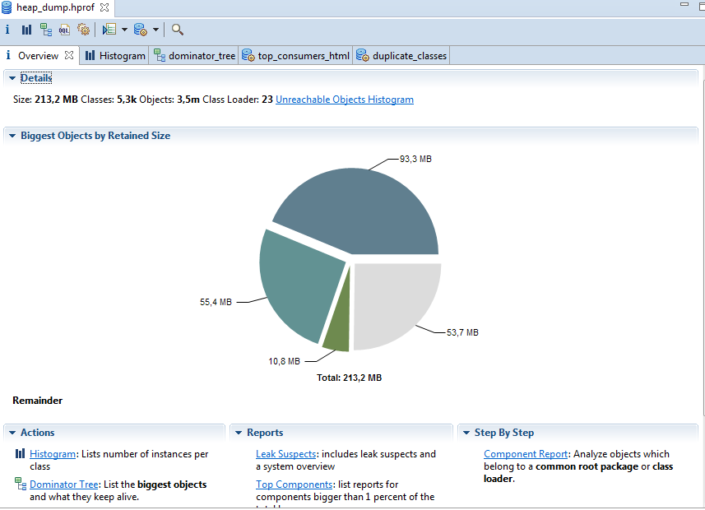
Tools (cont.)
Eclipse Memory Analizer displays lots of information from heap dump.

Slide 37
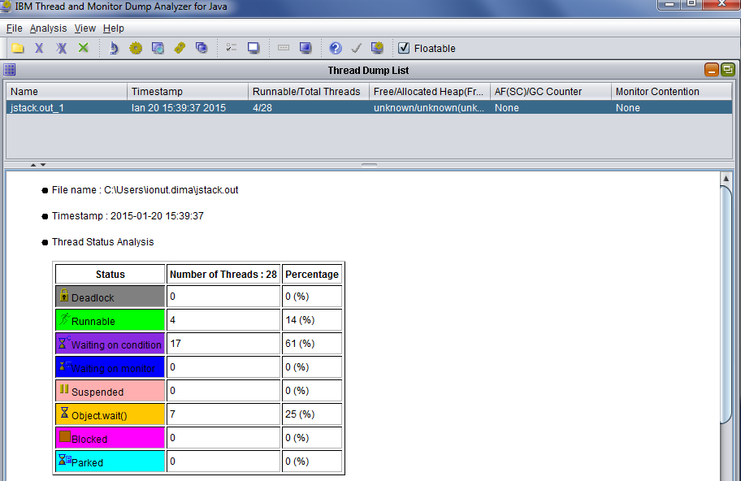
Tools (cont.)

Slide 38
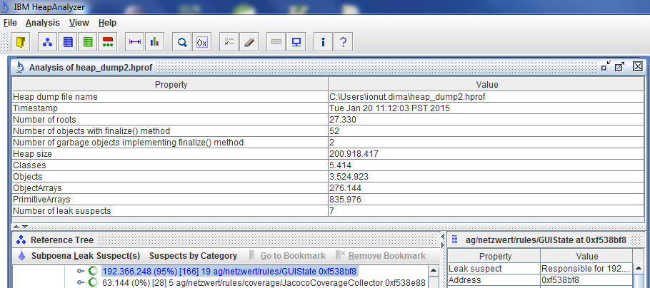
Tools (cont.)

Slide 39

Bibliography
OReilly Java Performance, The Definitive Guide

